Slide 1

BUSINESS DRESS

Slide 2
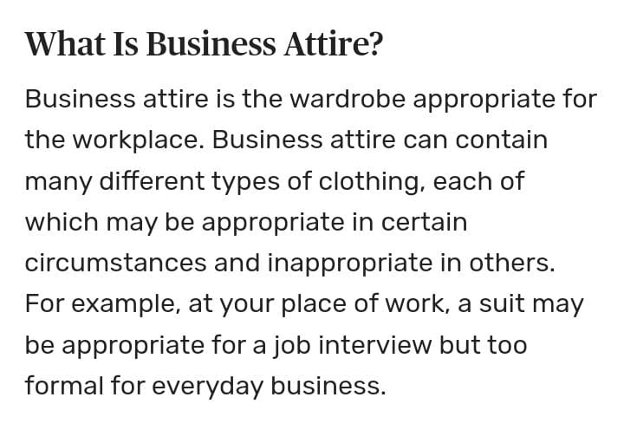
Business attire

Slide 3
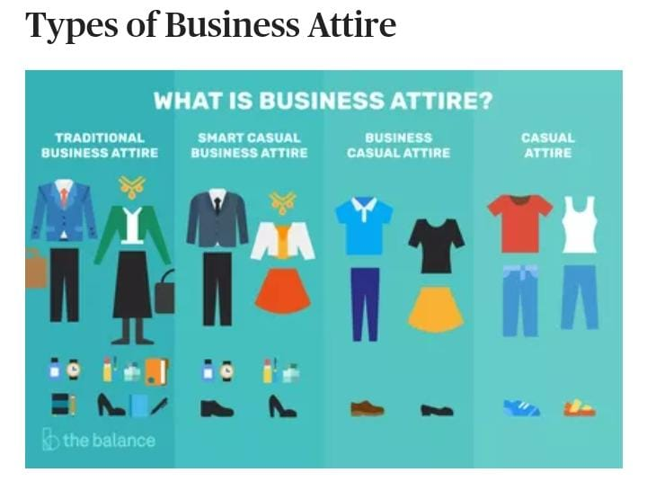






Types of business attire

Slide 4
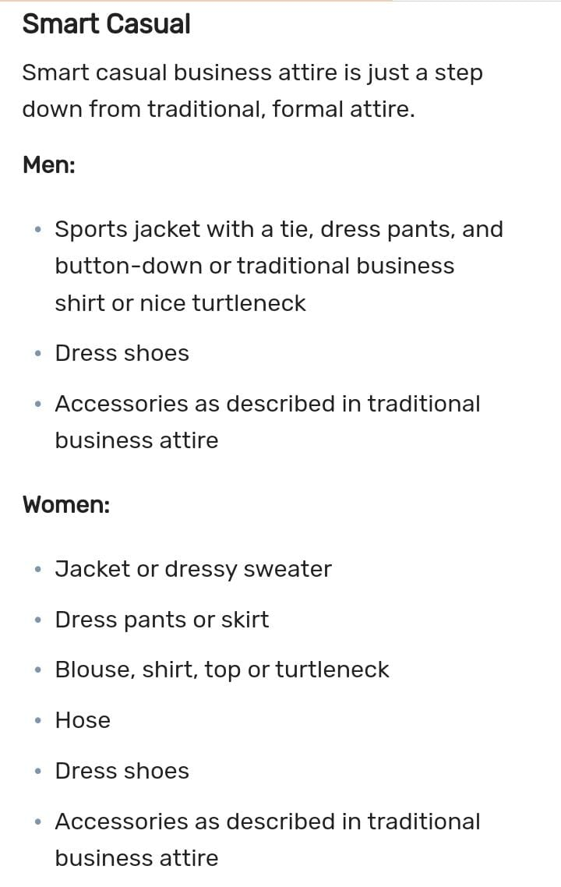
1.Smart casual

Slide 5
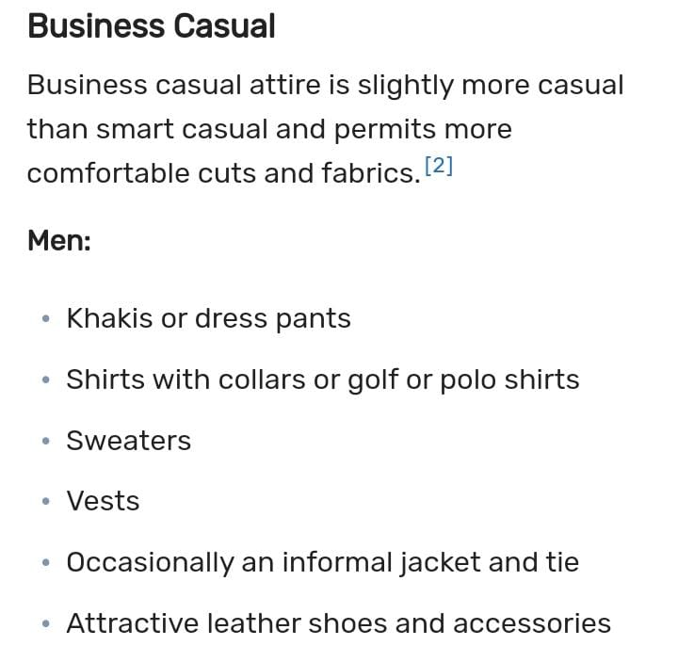
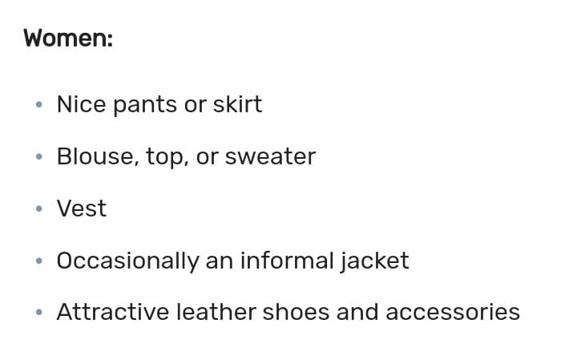
2.Business casual

Slide 6
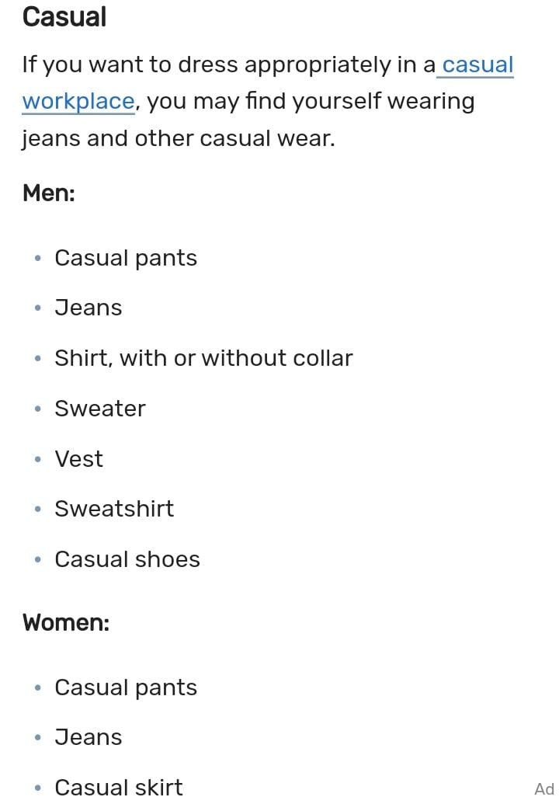
Casual

Slide 7
Thank you!

